Slide 1

About UIPI

Slide 2
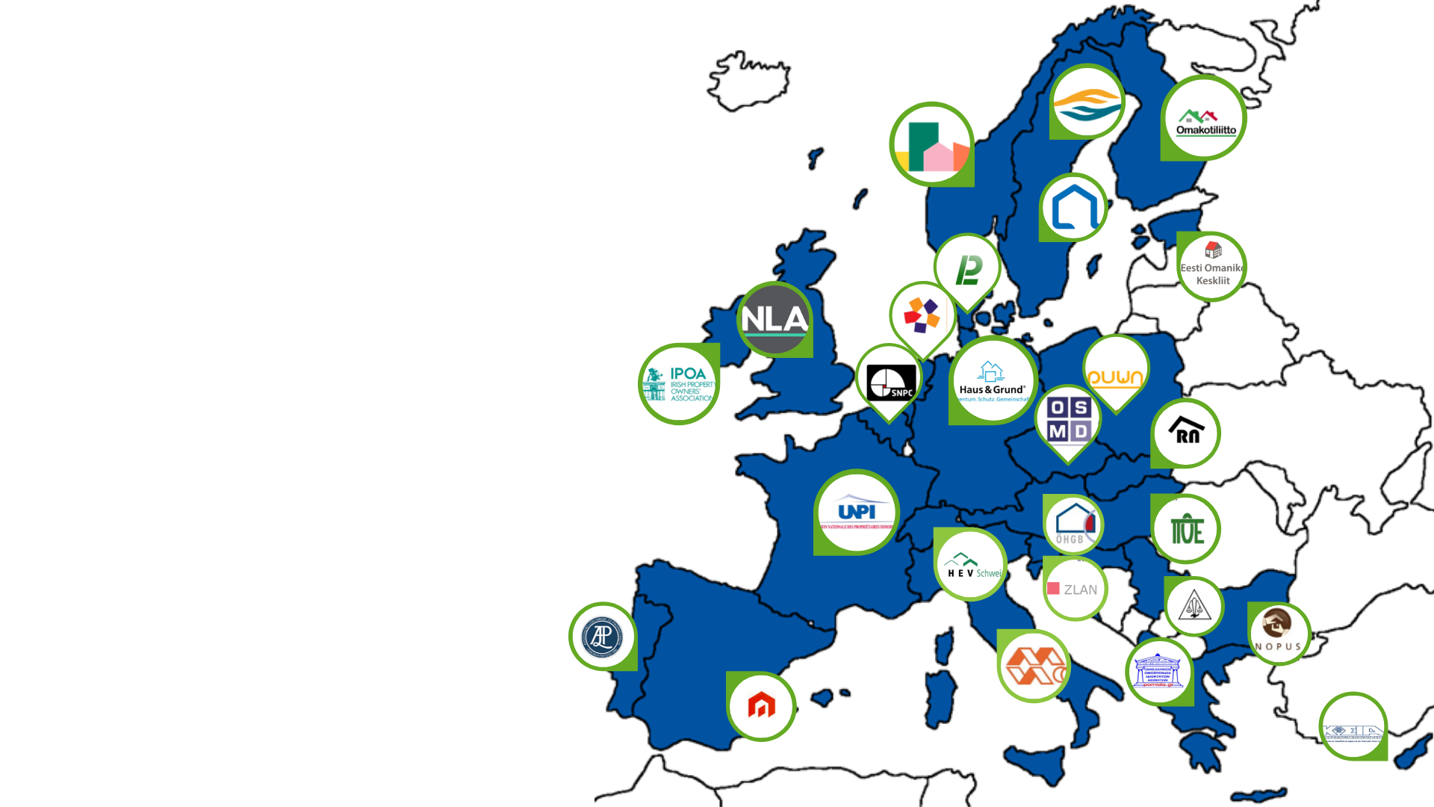


Who we are

Slide 3
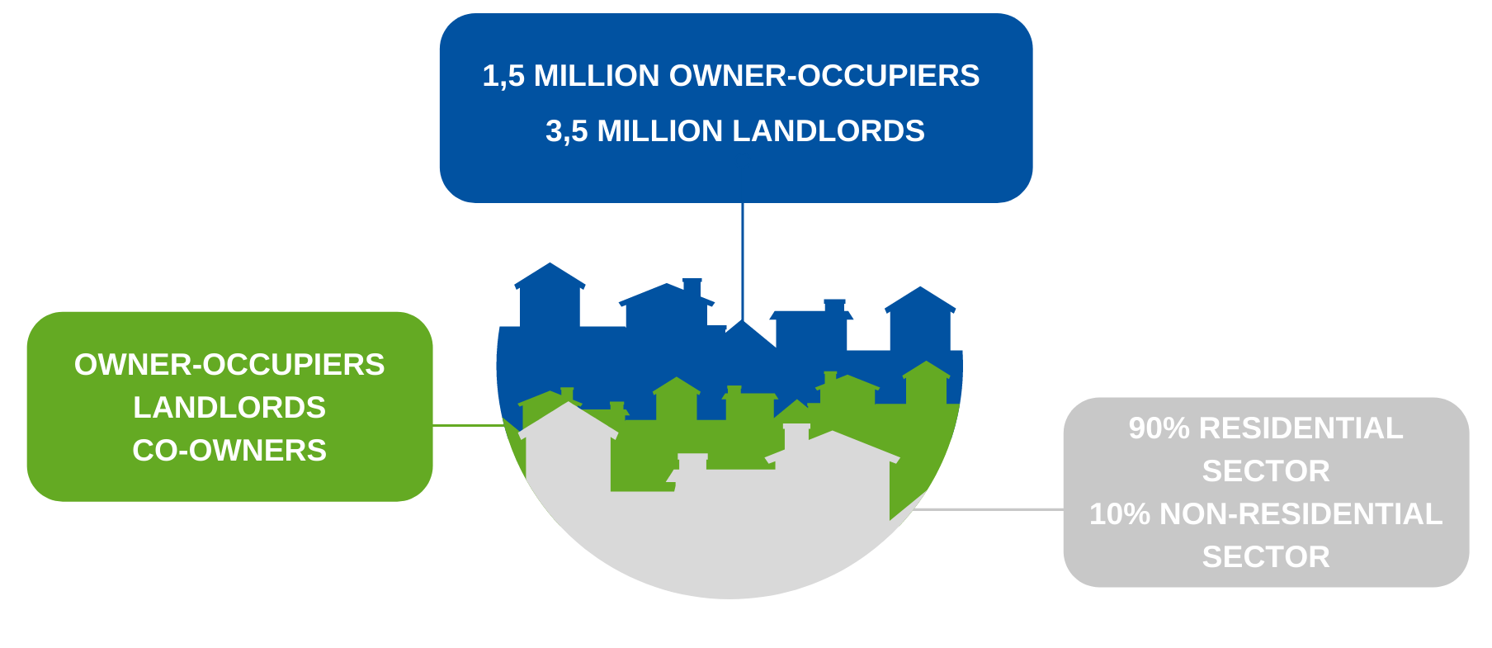
Who we represent

Slide 4


Slide 5


Slide 6
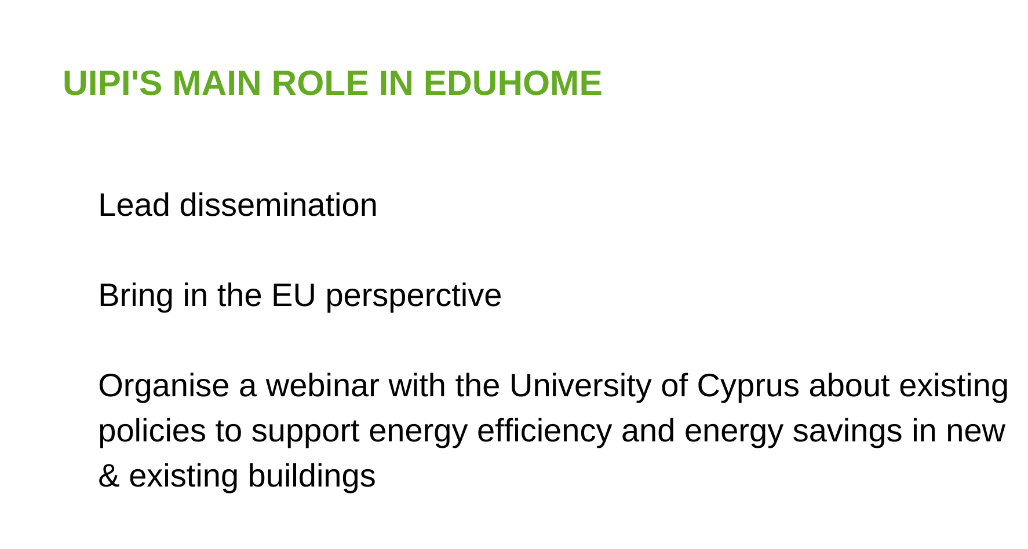

Slide 7
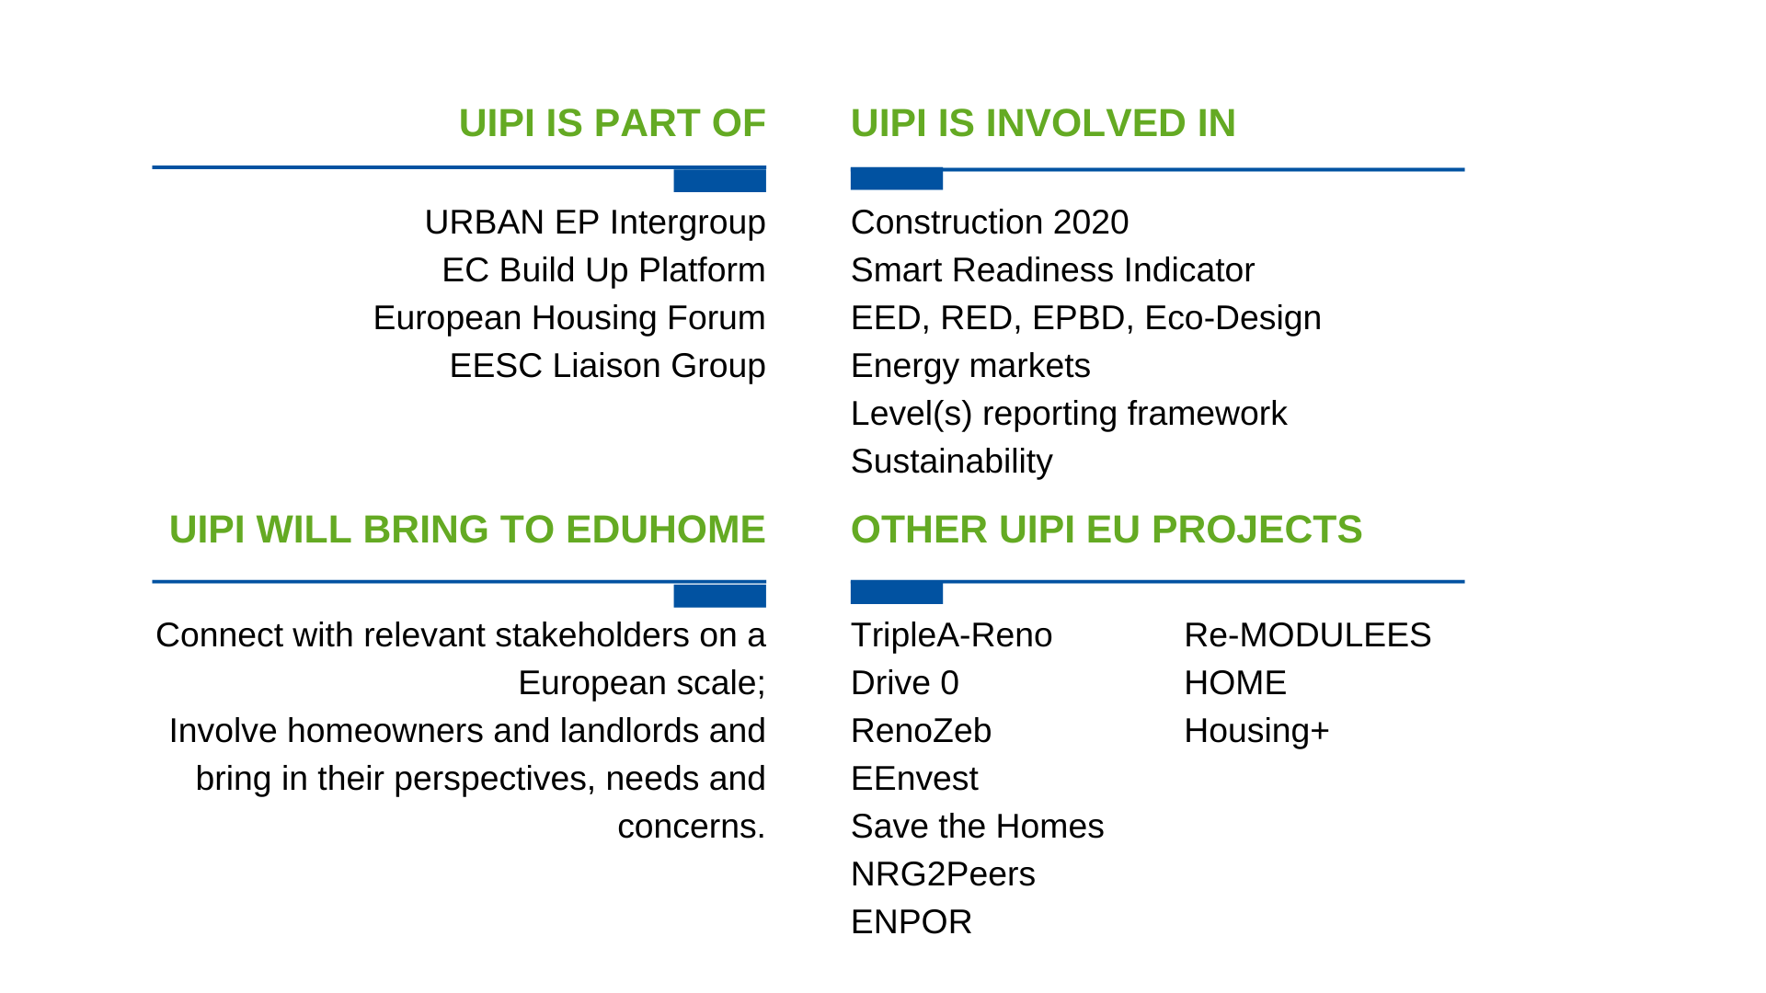

Slide 8


Belén Gutierrez
Communication

Slide 9



THANK YOU!
Emmanuelle Causse
Secretary General
causse@uipi.com
@Causse_EU

